Slide 1

Data Analysis Intern- Task1: Hotel Reservation
By: Suzy Adel Wahba Abdelshahid

Slide 2
01
Introduction
Task requirements & my steps to preform the task

Slide 3
Task Breakdown
In this Project, I will use SQL to answer the questions related to dataset. That will help me to develop my data analysis skills in a practical context.
Skills obtained:
Database Management Skills
Performance Tuning and Optimization
And this essential for organizing and retrieving data efficiently in various analytical tasks.

Slide 4
My Data Analysis Process
Exploratory data, understanding data types and what each attribute represents
SQL queries are used to analyze and manipulate data to derive insights.
Introduction
Analysis
Methodology
Conclusion
Prepare startigic questions that will help the business plan, and that are critical for decisions acordind to the collected data
involves creating views or temporary tables to organize and summarize data in a format suitable for reporting

Slide 5
Analysis
Data Analysis and Querying: Utilize SELECT statements with aggregate functions (e.g., SUM, COUNT, AVG), GROUP BY clauses, and JOIN operations to integrate data from multiple tables. Advanced analysis can leverage statistical functions and window functions (e.g., ROW_NUMBER(), RANK()) for deeper insights

Slide 6
02
Results
Question analysis response and Explaination

Slide 7
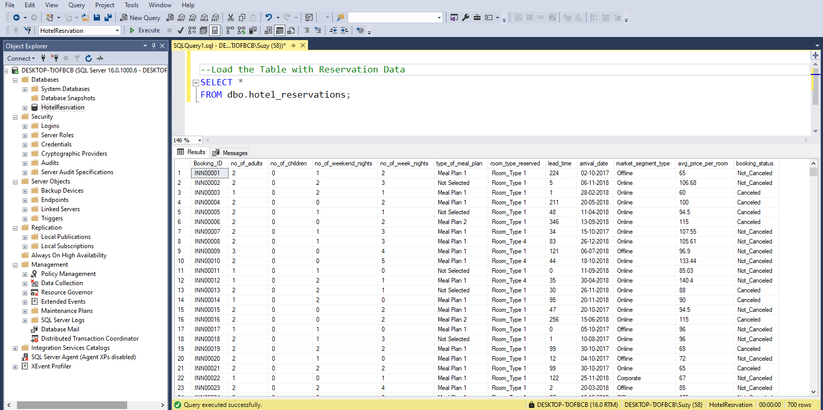
First setup an sql application then add a new database and the choose from tools to add a flat file and while importing the .csv make sure its in the original format , after that I still imported the table to recheck

Slide 8
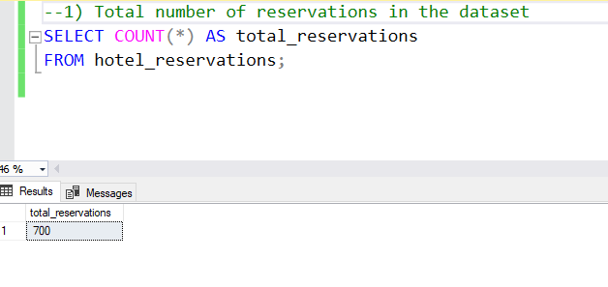
Even though this is present when importing the entire table in the previous slide however to show total number of reservations count * (all rows ) and show this as total reservations
= 700

Slide 9
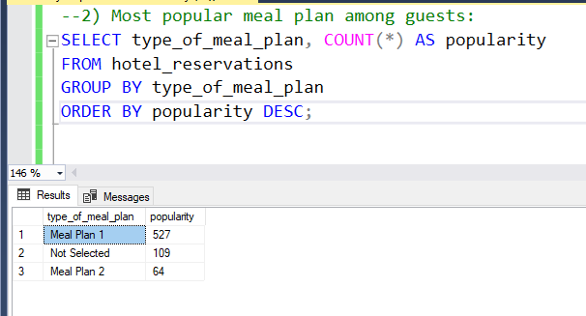
To get the most popular meal you have to count each type of meal occurrences and put the number in popularity column after grouping them , the result is meal plan 1 then unselected then meal plan 2 , leaving that MEAL PLAN 1 IS THE MOST POPULAR

Slide 10
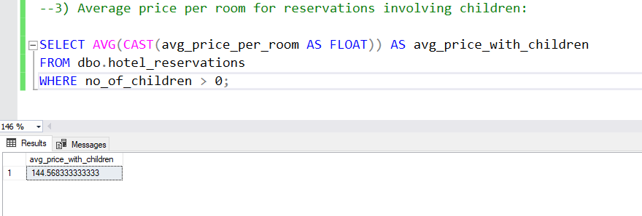
Calculate the average room price for reservations that include children by summing their room prices and dividing by the number of reservations involving children, however there is an internal AVG function , however most importantly type cast it as a float or numerical format to get a result ,
THE AVG PRICE IS 143.33

Slide 11
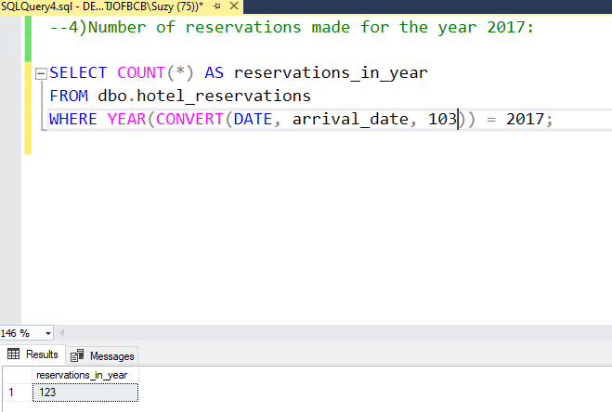
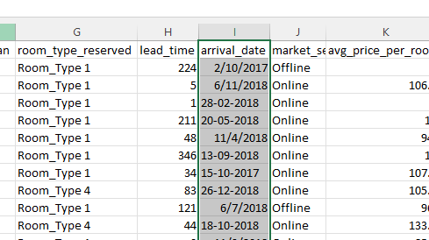
Count the number of reservations made within the specified year 2017 to determine the total. I chose 2017 and could of chosen 2018 as the dataset included a combination of only those two years, however I had to type cast the data as date and its specific format :
101 - MM/DD/YYYY
103 - DD/MM/YYYY
112 – YYYYMMDD
THE TOTAL RESERVATIONS IN 2017 IS 123

Slide 12
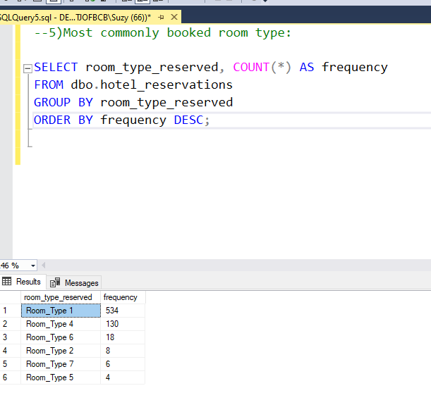
Identify the room type with the highest number of bookings by counting occurrences of each room type, and order them descending
THE MOST COMONLY BOOKED ROOM IS TYPE ROOM TYPE 1

Slide 13
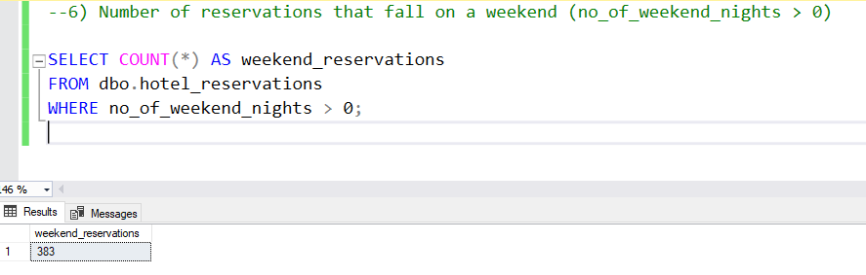
Count reservations where guests stayed overnight on a weekend to determine the total number THE WEEEKEND RESERVATIONS IS 383

Slide 14
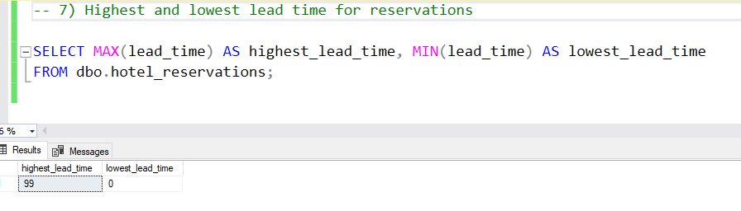
Find the maximum and minimum lead times (the period between booking and check-in) for all reservations using the internal max and min MAX /MIN .
THE MAX=99
THE MIN = 0

Slide 15
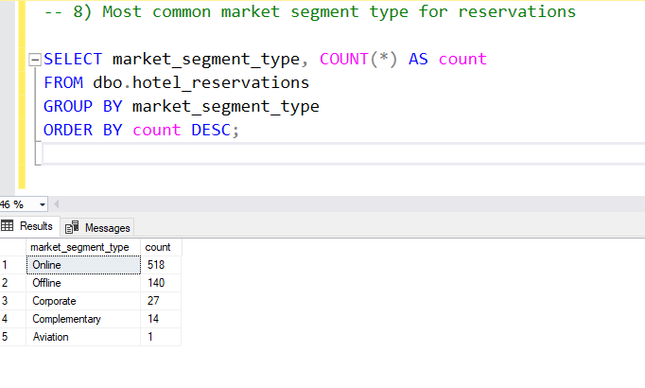
Determine the market segment type with the highest occurrence among reservations by counting each segment type and ordering it by descending order .
THE MOST COMMON MARKET SEGMENT IS ONLINE

Slide 16
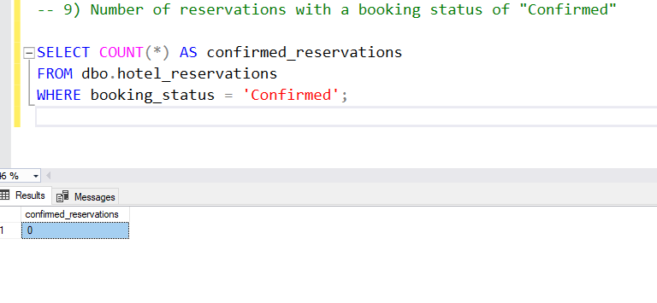
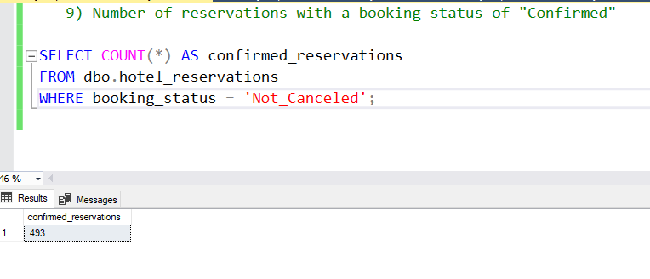
Count reservations that are marked as 'Confirmed' to determine the total number which according to the data set ‘Not_Cancelled’.
THE CONFIREMED RESERVATIONS 433

Slide 17
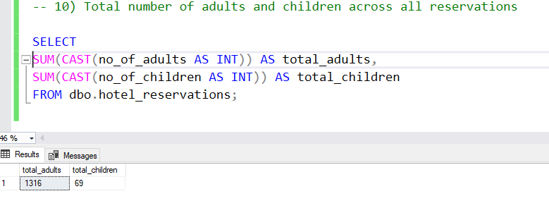
Calculate the sum of adults and children across all reservations to find the total count, but the type cast is integer as the people count is whole numbers.
TOTAL ADULTS = 1316
TOTAL CHILDREN = 69

Slide 18
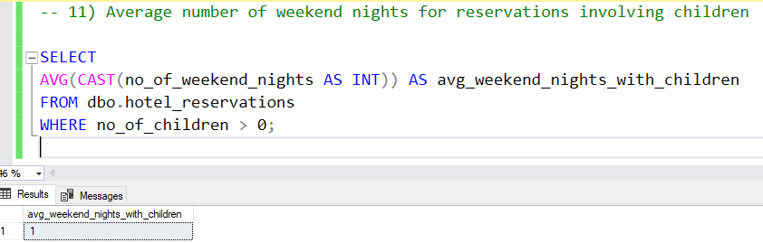
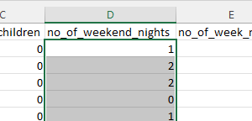
Calculate the average number of weekend nights (nights spent on weekends) for reservations where children were present, making sure number of weekend nights is type casted as integers.
AVG NO OF WEEDEND DAYS = 1

Slide 19
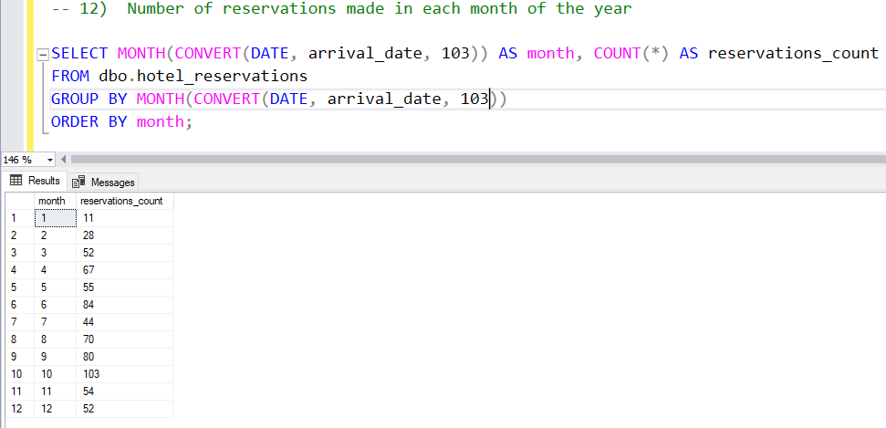
Count reservations made in each month of the specified year to understand booking trends over time, the order of the month differs from the different typecasting of dates, as mentioned before I picked the day/month/year.
Result in tables

Slide 20
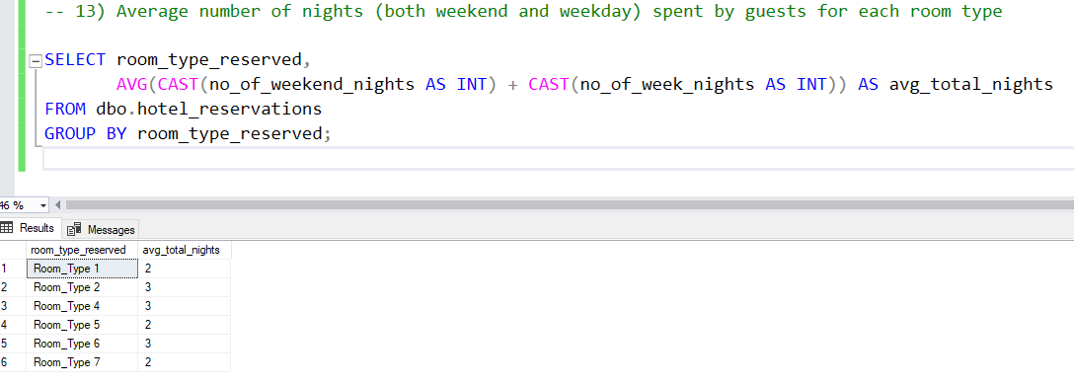
Calculate the average length of stay (weekend and weekday nights combined) for guests staying in each room type using AVG and GROUP BY ,internal functions, and type casting to perform the summation operation.
Result in table

Slide 21
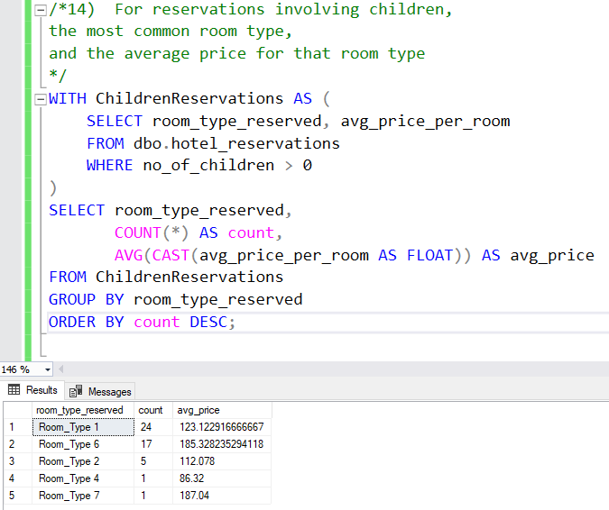
Identify the most frequently booked room type for reservations with children, and calculate its average price by counting it occurrences and ordering by it descending order .
Result in table

Slide 22
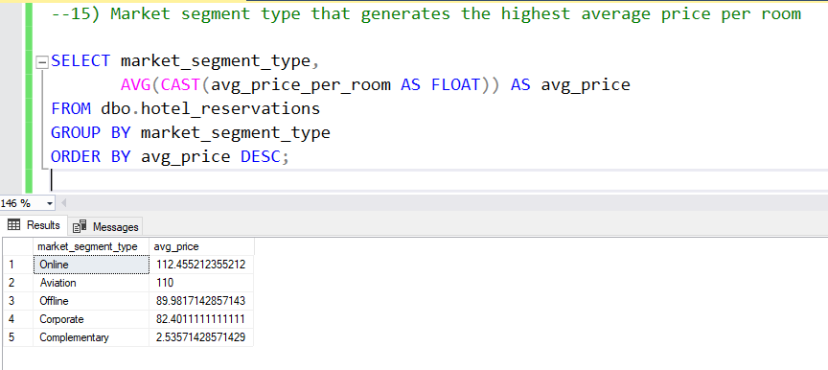
Determine the market segment type that, on average, results in the highest room prices by calculating average room prices for each segment and identifying the highest average.
ONLINE IS THE HIGHEST SEGMENT AND THE AVG IS 112.46

Slide 23
Conclusion

Slide 24
Thanks!
Do you have any questions?
suzyadel37@gamil.com
01204407191
www.mentorness.com

